Slide 1
Procedural vs structural language
The procedural language is written as a series of instructions
In this language, the programmer has to provide instructions about what is to be done and how it is to be done
The procedural language are more command-driven
Procedural programming is a top-down approach which means that it treats the data and the procedures as two separate entities.
The example of procedural language involves Fortran, basic, etc.
Structured programming is a method of programming designed to help make large programs easier to read and is a predecessor to Object-Oriented Programming.
Structural programming language is predefined language.
The Structural programming language are more function-driven
In Structural Programming Languages, the programmer needs to specify “what the program should do” rather than “how the program should perform the task”
The example of Structural language includes java, SQL, C++, Cobol, Fortran etc.

Slide 2
Data types
Primitive Data Types
A primitive data type specifies the size and type of variable values, and it has no additional methods.
Byte,short,int,long,float,double,Boolean and char
Non Primitive Data Type
Non-primitive data types are called reference types because they refer to objects.
Such as Arrays and classes

Slide 3
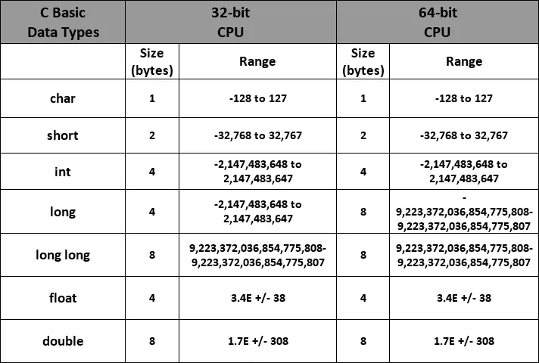
Primitive data type

Slide 4
OOPs concept
Abstraction: A car is viewed as a car rather than its individual components. The man only knows that pressing the accelerators will increase the car speed or applying brakes will stop the car, but he does not know how on pressing the accelerator, the speed is actually increasing. He does not know about the inner mechanism of the car or the implementation of the accelerators, brakes etc.
Encapsulation: The capsule, it is wrapped with different medicines. In a capsule, all medicine is encapsulated inside the capsule.
Polymorphism: If we consider a person in class room that time we behave like a student, when we are in market at that time we behave like a customer, when we at your home at that time we behave like a son or daughter, Here one person present in different-different behaviors.
Inheritance:children aquires parent properties

